Slide 1
Asymptotic Analysis
All about algorithm performance

Slide 2
Why performance analysis?
An Algorithm should take care of features, like user friendliness, modularity, security, maintainability, etc.
Performance is like currency through which we can buy all the above things.
To summarize, performance == scale. Imagine a text editor that can load 1000 pages, but can spell check 1 page per minute OR an image editor that takes 1 hour to rotate your image 90 degrees left OR … you get it. If a software feature can not cope with the scale of tasks users need to perform – it is as good as dead.

Slide 3
Which is better?
Given two algorithms for a task, how do we find out which one is better?
Okay. Implement both the algorithms and run the two programs on your computer and see which one takes less time.
Will the evaluation be absolute?

Slide 4
Problem with run time
If the performance is based on run time, we see the following issue:
It might be possible that for some inputs, first algorithm performs better than the second. And for some inputs second performs better.
It might also be possible that for some inputs, first algorithm perform better on one machine and the second works better on other machine for some other inputs.
Notes:
Bubble sort: reverse sorted
Selection sort: all except first element is sorted. And smallest element is at the end.
Calculate number of comparisons and number of swaps.

Slide 5
Asymptotic Analysis
Consider the following function:
F(x) = 1/(x-2)
Desmos | Graphing Calculator
Notes:
Asymptote: a function approaching the given curve but does not meet it at any finite distance.

Slide 6
How is it better?
In Asymptotic Analysis, we evaluate the performance of an algorithm in terms of input size (we don’t measure the actual running time).
We calculate, how the time (or space) taken by an algorithm increases with the input size.

Slide 7
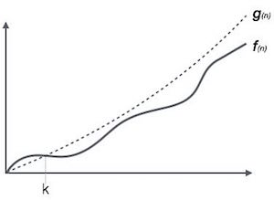
Big O
Ο(f(n)) = { g(n) : there exists c > 0 and n₀ such that f(n) ≤ c.g(n) for all n > n₀. }

Slide 8
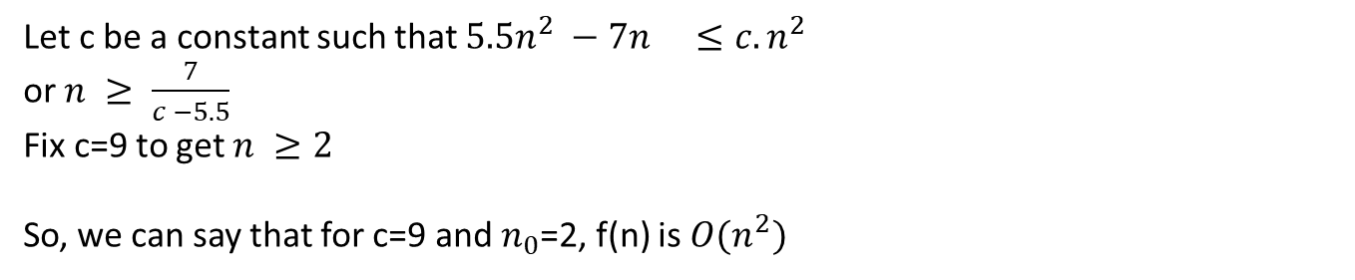
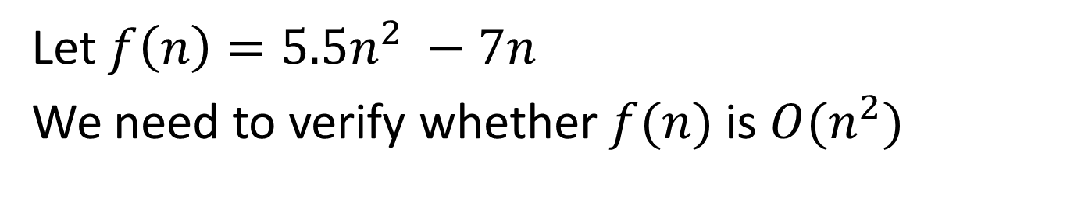
Example
Let $f\left(n\right)=5.5n^{2} −7n^{}$
We need to verify whether $f(n)$ is $O(n^{2})$
Let c be a constant such that $5.5n^{2} −7n^{} ≤c.n^{2}$
or $n ≥ \frac{7}{c −5.5}$
Fix c=9 to get $n ≥2$
So, we can say that for c=9 and $n_{0}$=2, f(n) is $O(n^{2})$

Slide 9
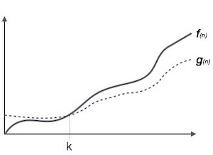
Omega
Ω(f(n)) ≥ { g(n) : there exists c > 0 and n₀ such that g(n) ≤ c.f(n) for all n > n₀. }

Slide 10
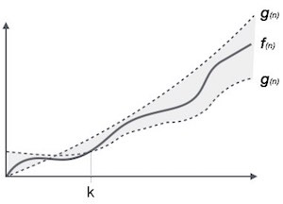
Theta
θ(f(n)) = { g(n) if and only if g(n) = Ο(f(n)) and g(n) = Ω(f(n)) for all n > n₀. }

Slide 11
Is it always better?
Asymptotic Analysis is not perfect, but that’s the best way available for analyzing algorithms.
For example, say there are two sorting algorithms that take 1000nLogn and 2nLogn time respectively on a machine. Both of these algorithms are asymptotically same (order of growth is nLogn). So, With Asymptotic Analysis, we can’t judge which one is better as we ignore constants in Asymptotic Analysis.
Also, in Asymptotic analysis, we always talk about input sizes larger than a constant value. It might be possible that those large inputs are never given to your software and an algorithm which is asymptotically slower, always performs better for your particular situation. So, you may end up choosing an algorithm that is Asymptotically slower but faster for your software.

Slide 12
Question
int a = 0, b = 0;
for (i = 0; i < N; i++) {
a = a + rand();
}
for (j = 0; j < M; j++) {
b = b + rand();
}

Slide 13
Question
int a = 0;
for (i = 0; i < N; i++) {
for (j = N; j > i; j--) {
a = a + i + j;
}
}

Slide 14
Question
int i, j, k = 0;
for (i = n / 2; i <= n; i++) {
for (j = 2; j <= n; j = j * 2) {
k = k + n / 2;
}
}

Slide 15
Question
int a = 0, i = N;
while (i > 0) {
a += i;
i /= 2;
}

Slide 16
Question
void fun(int n)
{
for(int i=0;i*i<n;i++)
cout<<"GeeksforGeeks";
}

Slide 17
Solution
The loop will stop when i * i >=n
i.e., i*i=n
i*i=n ⇒ k² = n
k =√n
Hence, the time complexity is O(√n).

Slide 18
Question
void fun(int n)
{
if (n < 5)
cout << "GeeksforGeeks";
else {
for (int i = 0; i < n; i++) {
cout << i;
}
}
}

Slide 19
Question
void fun(int a, int b)
{
while (a != b) {
if (a > b)
a = a - b;
else
b = b - a;
}
}

Slide 20
Linear Search
#include <stdio.h>
int search(int arr[], int size, int x) {
int i=0;
for (i=0; i<size; i++)
if (arr[i] == x)
return i;
return -1;
}
int main() {
int arr[] = {2,3,1,5};
int size = sizeof(arr) / sizeof(arr[0]);
int find = 1;
printf("Position of %d is %d\n", find, search(arr,size,find));
return 0;
}

Slide 21
Worst Case
The worst case will take place if:
1. The element to be search is in the last index
2. The element to be search is not present in the list
In both cases, the maximum number of comparisons take place in Linear Search which is equal to N comparisons.
Hence, the Worst Case Time Complexity of Linear Search is O(N).

Slide 22
Best Case
The Best Case will take place if: The element to be search is on the first index.
The number of comparisons in this case is 1. Therefore, Best Case Time Complexity of Linear Search is O(1).

Slide 23
Average Case
Let there be N distinct numbers: a1, a2, ..., a(N-1), aN.
We need to find element P.
There are two cases:
Case 1: The element P can be in N distinct indexes from 0 to N-1.
Case 2: There will be a case when the element P is not present in the list.
There are N case 1 and 1 case 2. So, there are N+1 distinct cases to consider in total.

Slide 24
Average Case: Contd
If element P is in index K, then Linear Search will do K+1 comparisons.
Number of comparisons for all cases in case 1 = Comparisons if element is in index 0 + Comparisons if element is in index 1 + ... + Comparisons if element is in index N-1 = 1 + 2 + ... + N = N * (N+1) / 2 comparisons
If element P is not in the list, then Linear Search will do N comparisons.
Number of comparisons for all cases in case 2 = N
Therefore, total number of comparisons for all N+1 cases = N * (N+1) / 2 + N
= N * ((N+1)/2 + 1)
Average number of comparisons = ( N * ((N+1)/2 + 1) ) / (N+1)
= N/2 + N/(N+1)

Slide 25
Space Complexity
As the amount of extra data in Linear Search is fixed, the Space Complexity is O(1).

Slide 26
Binary Search
int binarySearch(int[] A, int x) {
int low = 0, high = A.length - 1;
while (low <= high) {
int mid = (low + high) / 2;
if (x == A[mid]) {
return mid;
}
else if (x < A[mid]) {
high = mid - 1;
}
else {
low = mid + 1;
}
}
return -1;
}

Slide 27
Worst Case
The worst case of Binary Search occurs when: The element is to search is in the first index or last index
In this case, the total number of comparisons required is logN comparisons.
Therefore, Worst Case Time Complexity of Binary Search is O(logN).

Slide 28
Best Case
The best case of Binary Search occurs when: The element to be search is in the middle of the list
In this case, the element is found in the first step itself and this involves 1 comparison.
Therefore, Best Case Time Complexity of Binary Search is O(1).

Slide 29
Average Case
Let there be N distinct numbers: a1, a2, ..., a(N-1), aN. We need to find element P.
There are two cases:
Case 1: The element P can be in N distinct indexes from 0 to N-1.
Case 2: There will be a case when the element P is not present in the list.
There are N case 1 and 1 case 2. So, there are N+1 distinct cases to consider in total.

Slide 30
Average Case Contd.
The element at index N/2 can be found in 1 comparison as Binary Search starts from middle.
Similarly, in the 2nd comparisons, elements at index N/4 and 3N/4 are compared based on the result of 1st comparison.
On this line, in the 3rd comparison, elements at index N/8, 3N/8, 5N/8, 7N/8 are compared based on the result of 2nd comparison.
Based on this, we know that:
Elements requiring 1 comparison: 1
Elements requiring 2 comparisons: 2
Elements requiring 3 comparisons: 4
Therefore, Elements requiring I comparisons: 2^(I-1)

Slide 31
Average Case Contd.
The maximum number of comparisons = Number of times N is divided by 2 so that result is 1 = Comparisons to reach 1st element = logN comparisons
I can vary from 0 to logN
Total number of comparisons = 1 * (Elements requiring 1 comparison) + 2 * (Elements requiring 2 comparisons) + ... + logN * (Elements requiring logN comparisons)
Total number of comparisons = 1 * (1) + 2 * (2) + 3 * (4) + ... + logN * (2^(logN-1))
= 1 + 4 + 12 + 32 + ... = 2^logN * (logN - 1) + 1
= N * (logN - 1) + 1
Total number of cases = N+1
Therefore, average number of comparisons = ( N * (logN - 1) + 1 ) / (N+1)
The dominant term is N * logN / (N+1) which is approximately logN. Therefore, Average Case Time Complexity of Binary Search is O(logN).

Slide 32
Selection Sort
void selectionSort(int numbers[], int array_size) {
int i, j, T, min, count;
for (i = 0; i < array_size; i++) {
min = i;
for (j = i + 1; j < array_size; j++) {
if (numbers[j] < numbers[min]) {
min = j; }
}
T = numbers[min];
numbers[min] = numbers[i];
numbers[i] = T;
}
}

Slide 33
Worst Case
The worst case is the case when the array is already sorted (with one swap) but the smallest element is the last element.
For example, if the sorted number as a1, a2, ..., aN, then:
a2, a3, ..., aN, a1
will be the worst case for our particular implementation of Selection Sort.

Slide 34
Worst Case Contd.
Hence, the worst case has:
N * (N+1) / 2 comparisons
N swaps
Hence, the time complexity is O(N^2).

Slide 35
Best Case
The best case is the case when the array is already sorted.
For example, if the sorted number as a1, a2, ..., aN, then:
a1, a2, a3, ..., aN
will be the best case for our particular implementation of Selection Sort.

Slide 36
Best Case Contd.
Hence, the best case has:
N * (N+1) / 2 comparisons
0 swaps
Note only the number of swaps has changed. Hence, the time complexity is O(N^2).

Slide 37
Average Case
Number of comparisons = N * (N+1) / 2
Therefore, the time complexity will be O(N^2).

Slide 38
Bubble Sort
void bubbleSort (int S[ ], int length) {
bool isSorted = false;
while(!isSorted)
{
isSorted = true;
for(int i = 0; i<length; i++)
{
if(S[i] > S[i+1])
{
int temp = S[i];
S[i] = S[i+1];
S[i+1] = temp;
isSorted = false;
}
}
length--;
}
}

Slide 39
Worst Case
No of comparisons: ½ (n² – n)
O(N²)

Slide 40
Best Case
If the numbers are already sorted in ascending order, the algorithm will determine in the first iteration that no number pairs need to be swapped and will then terminate immediately.
The algorithm must perform n-1 comparisons; therefore:
Complexity: Omega(N)

Slide 41
Average Case
The average time complexity of Bubble Sort case is: Theta(n²)

Slide 42
Insertion Sort
void insertionSort(int array[], int length)
{
int i, j, value;
for(i = 1; i < length; i++)
{
value = a[i];
for (j = i - 1; j >= 0 && a[ j ] > value; j--)
{
a[j + 1] = a[ j ];
}
a[j + 1] = value;
}
}

Slide 43
Worst Case
The worst-case time complexity of Insertion Sort is: O(n²)

Slide 44
Best Case
The best-case time complexity of Insertion Sort is: Omega(n)

Slide 45
Average Case
The average-case time complexity of Insertion Sort is: Theta(n²)

Slide 46
Till Now
Algorithm | Worst Case | Average Case | Best Case | Space Complexity
Linear Search | O(N) | Θ(N) | Ω(1) | O(1)
Binary Search | O(log N) | Θ(log N) | Ω(1) | O(1)
Selection Sort | O(N²) | Θ(N²) | Ω(N²) | O(1)
Bubble Sort | O(N²) | Θ(N²) | Ω(N) | O(1)
Insertion Sort | O(N²) | Θ(N²) | Ω(N) | O(1)

Slide 47
Recurrence Relation
T(n)=1 for n=0
T(n)=1+T(n-1) for n>0

Slide 48
Recurrence Relation
T(n)=1+T(n/2) for n>0
T(n) = 1 for n=1

Slide 49
Recurrence Relation
a_{n} = 2 a_{n−1}−1 and a₁ = 3, Solve the recurrence relation.

Slide 50
Recurrence Relation
a_{n} = 5 a_{n−1}−1 and a₁ = 3, Solve the recurrence relation.
The above recurrence relation can be written as:
T(n) = 5 T(n-1) – 1. Now solve as per the usual method.

Slide 51
Characteristic Root Technique
Suppose we want to solve a recurrence relation expressed as a combination of the two previous terms, such as a_{n}=a_{n−1}+6a_{n−2}.
The characteristic equation in this case is:
x² – x – 6 = 0
If the roots of the equation are distinct, then
a_{n} = ar₁^{n} + br₂^{n}
where a and b are constants defined by initial condition.
Why?
http://discrete.openmathbooks.org/dmoi2/sec_recurrence.html

Slide 52
Characteristic Root Technique
If the roots of the equation are same, then
a_{n} = ar^{n} + bnr^{n}
where a and b are constants defined by initial condition.

Slide 53
Characteristic Root Technique
a_{n} = 6 * a_{n−1} − 9 * a_{n−2}
a₀ = 1 and a₁ = 4.

Slide 54
Exercise
Solve the recurrence relation a_{n}=a_{n−1}+2^{n} with a₀=5.

Slide 55
Master’s Theorem
Dividing Functions T(n) = aT(n/b) + f(n)
Decreasing Functions T(n) = aT(n-b) + f(n)
Why master theorem works?
https://www.scaler.com/topics/data-structures/masters-theorem/

Slide 56
Dividing Functions
T(n) = aT(n/b) + f(n) where f(n) = Theta(n^k*log(^p)n)
Example:
T(n) = 2T(n/2) + n^2
T(n) = T(n/4) + nlogn

Slide 57
Cases
Case 1: if log_{b}a > k, then:
T(n) = Theta(n^ log_{b}a)
Case 2: if log_{b}a = k, then:
If p>-1, then T(n) = Theta(n^k log^{(p+1)}n)
If p=-1, then T(n) = Theta(n^k loglogn)
Case 3: if log_{b}a < k, then:
If p>=0, then T(n) = Theta(n^k log^{p}n)
If p<0, then T(n) = Theta(n^k)

Slide 58
Decreasing Function
T(n) = aT(n-b) + f(n) where f(n) = Theta(n^k)
Example
T(n) = T(n-2) + 1
T(n) = 2*T(n-1) + n^2

Slide 59
Cases
If a<1, then T(n) = Theta(n^k)
If a=1, then T(n) = Theta(n^(k+1))
If a>1, then T(n) = Theta(n^(a/b) * f(n))

Slide 60
Merge Sort
void merge(int*,int*,int,int,int);
void mergesort(int *a, int*b, int low, int high) {
int pivot;
if(low<high) {
pivot=(low+high)/2;
mergesort(a,b,low,pivot);
mergesort(a,b,pivot+1,high);
merge(a,b,low,pivot,high);
}
}
int main() {
int a[] = {12,10,43,23,78,45,56,98,41,90,24};
int num; num = sizeof(a)/sizeof(int);
int b[num];
mergesort(a,b,0,num-1);
for(int i=0; i<num; i++) cout<<a[i]<<" "; cout<<endl; }

Slide 61
void merge(int *a, int *b, int low, int pivot, int high) {
int h,i,j,k; h=low; i=low; j=pivot+1;
while((h<=pivot)&&(j<=high)) {
if(a[h]<=a[j]) { b[i]=a[h]; h++; }
else { b[i]=a[j]; j++; }
i++; }
if(h>pivot) {
for(k=j; k<=high; k++) {
b[i]=a[k]; i++; } }
else {
for(k=h; k<=pivot; k++) {
b[i]=a[k]; i++; } }
for(k=low; k<=high; k++) a[k]=b[k]; }

Slide 62
Complexity Analysis
Worst Case Time Complexity: O(n*log n)
Best Case Time Complexity: Omega(n*log n)
Average Time Complexity: Theta(n*log n)
Space Complexity: Depends on implementation. If array then O(N) else if linked list O(1).

Slide 63
Till Now
Algorithm | Worst Case | Average Case | Best Case | Space Complexity
Linear Search | O(N) | Θ(N) | Ω(1) | O(1)
Binary Search | O(log N) | Θ(log N) | Ω(1) | O(1)
Selection Sort | O(N²) | Θ(N²) | Ω(N²) | O(1)
Bubble Sort | O(N²) | Θ(N²) | Ω(N) | O(1)
Insertion Sort | O(N²) | Θ(N²) | Ω(N) | O(1)
Merge Sort | O(N log N) | Θ(N log N) | Ω(N log N) | O(N)/O(1)

Slide 64
Quick Sort
void quickSort(int a[], int first, int last);
int pivot(int a[], int first, int last);
void swap(int& a, int& b);
Void main()
{
int test[] = { 7, -13, 1, 3, 10, 5, 2, 4 };
int N = sizeof(test)/sizeof(int);
quickSort(test, 0, N-1);
}
void swap(int& a, int& b) {
int temp = a;
a = b;
b = temp;
}

Slide 65
void quickSort( int a[], int first, int last) {
int pivotElement;
if(first < last) {
pivotElement = pivot(a, first, last);
quickSort(a, first, pivotElement-1);
quickSort(a, pivotElement+1, last); }
}
int pivot(int a[], int first, int last){
int p = first;
int pivotElement = a[first];
for(int i = first+1 ; i <= last ; i++){
if(a[i] <= pivotElement){
p++;
swap(a[i], a[p]);
}
}
swap(a[p], a[first]);
return p;
}

Slide 66
Complexity Analysis
Worst Case Time Complexity: O(n²)
Best Case Time Complexity: Omega(n*log n)
Average Time Complexity: Theta(n*log n)
Space Complexity: O(N)

Slide 67
Till Now
Algorithm | Worst Case | Average Case | Best Case | Space Complexity
Linear Search | O(N) | Θ(N) | Ω(1) | O(1)
Binary Search | O(log N) | Θ(log N) | Ω(1) | O(1)
Selection Sort | O(N²) | Θ(N²) | Ω(N²) | O(1)
Bubble Sort | O(N²) | Θ(N²) | Ω(N) | O(1)
Insertion Sort | O(N²) | Θ(N²) | Ω(N) | O(1)
Merge Sort | O(N log N) | Θ(N log N) | Ω(N log N) | O(N)/O(1)
Quick Sort | O(N²) | Θ(N log N) | Ω(N log N) | O(N)

Slide 68
Heap Sort
void heapify(int arr[], int n, int i) {
int largest = i;
int left = 2 * i + 1;
int right = 2 * i + 2;
if (left < n && arr[left] > arr[largest])
largest = left;
if (right < n && arr[right] > arr[largest])
largest = right;
if (largest != i) {
swap(&arr[i], &arr[largest]);
heapify(arr, n, largest);
}}

Slide 69
Contd.
void heapSort(int arr[], int n) {
for (int i = n / 2 - 1; i >= 0; i--)
heapify(arr, n, i);
for (int i = n - 1; i >= 0; i--) {
swap(&arr[0], &arr[i]);
heapify(arr, i, 0);
}
}

Slide 70
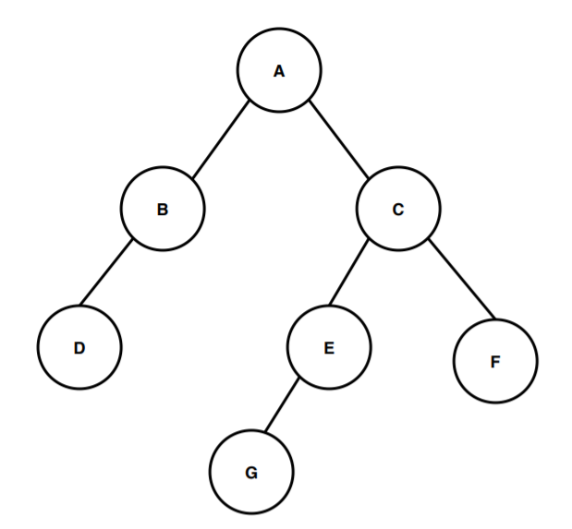
Height of a Tree
The height of a binary tree is the height of the root node in the whole binary tree.
In other words, the height of a binary tree is equal to the largest number of edges from the root to the most distant leaf node.

Slide 71
Time Complexity
The time complexity of heapsort consists of three parts:
Complexity of inserting a new node
Complexity of removing the max valued node from heap
Complexity of creating a heap

Slide 72
New Node Insertion
When we insert a new value in the heap when making the heap, the max number of steps we would need to take comes out to be O(log(n)).
As we use binary trees, we know that the max height of such a structure is always O(log(n)).
When we insert a new value in the heap, we will swap it with a value greater than it, to maintain the max-heap property. The number of such swaps would be O(log(n)).

Slide 73
Removal of Max Node
When we remove the max valued node from the heap, to add to the end of the list, the max number of steps required would also be O(log(n)).
Since we swap the max valued node till it comes down to the bottom-most level, the max number of steps we'd need to take is the same as when inserting a new node, which is O(log(n)).

Slide 74
Heap Creation
When we create a heap, not all nodes will move down O(log(n)) times.
The nodes at the bottom-most level (given by n/2) won't move down at all. The nodes at the second last level (n/4) would move down 1 time, as there is only one level below remaining to move down. The nodes at the third last level would move down 2 times, and so on.
So if we multiply the number of moves we take for all nodes, mathematically, it would turn out like a geometric series, as explained below-
(n/2 * 0) + (n/4 * 1) + (n/8 * 2) + (n/16 * 3) + ...h
Here h represents the height of the max-heap structure.

Slide 75
Analysis
Mathematically, we see that-
The first remove of a node takes log(n) time
The second remove takes log(n-1) time
The third remove takes log(n-2) time
and so on till the last node, which will take log(1) time
So summing up all the terms, we get-
log(n) + log(n-1) + log(n-2) + ....log(1) as log(x) + log(y) = log(x * y), we get =log(n∗(n−1)∗(n−2)∗…∗2∗1) =log(n!) Upon further simplification (using Stirling's approximation), log(n!) turns out to be =n∗log(n)−n+O(log(n))

Slide 76
Complexity Analysis
Worst Case Time Complexity: O((n*log n)
Best Case Time Complexity: Omega(n)
Average Time Complexity: Theta(n*log n)
Space Complexity: O(1)

Slide 77
Till Now
Algorithm | Worst Case | Average Case | Best Case | Space Complexity
Linear Search | O(N) | Θ(N) | Ω(1) | O(1)
Binary Search | O(log N) | Θ(log N) | Ω(1) | O(1)
Selection Sort | O(N²) | Θ(N²) | Ω(N²) | O(1)
Bubble Sort | O(N²) | Θ(N²) | Ω(N) | O(1)
Insertion Sort | O(N²) | Θ(N²) | Ω(N) | O(1)
Merge Sort | O(N log N) | Θ(N log N) | Ω(N log N) | O(N)/O(1)
Quick Sort | O(N²) | Θ(N log N) | Ω(N log N) | O(N)
Heap Sort | O(N log N) | Θ(N log N) | Ω(N) | O(1)

Slide 78
Problem Solving Strategies
Divide and conquer
Backtracking
Greedy
Dynamic Programming
Branch and Bound
Source: https://www.enjoyalgorithms.com/blog/problem-solving-approaches-in-data- structures-and-algorithms

Slide 79
Incremental Approach
Our daily problem-solving activities: build partial step-by-step solution using loops.
Input-centric: process one input at each iteration.
Output-centric: add one output at each iteration.
Iterative-improvement: start with approximation solution and improve upon it.
Example: Insertion Sort, Finding max and min in an array, Valid mountain array, Find equilibrium index of an array, Dutch national flag problem, Sort an array in a waveform.

Slide 80
Decrease and Conquer Approach
This is based on solution to a given problem via its one sub-problem solution.
Such as approach leads naturally to a recursive algorithm, which reduces the problem to a sequence of smaller input sizes.
This is continued till it reaches recursion’s base case.
Example: Euclid algorithm of finding GCD, Binary Search, Josephus problem.

Slide 81
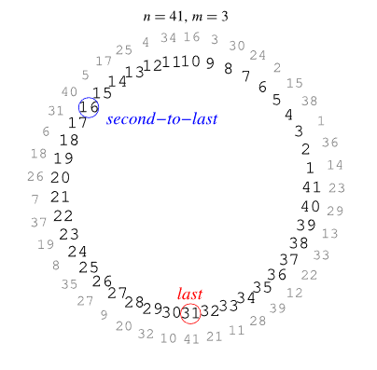
Josephus Problem
Given a group of n men arranged in a circle under the edict that every mth man will be executed going around the circle until only one remains, find the position L(n,m) in which you should stand in order to be the last survivor (Ball and Coxeter 1987).

Slide 82
Solution
#include <stdio.h>
int josephus(int n, int k)
{
if (n == 1)
return 1;
else
/* The position returned by josephus(n - 1, k) is
adjusted because the recursive call josephus(n -
1, k) considers the original position
k%n + 1 as position 1 */
return (josephus(n - 1, k) + k - 1) % n + 1;
}
int main()
{
int n = 14;
int k = 2;
printf("The chosen place is %d", josephus(n, k));
return 0;
}

Slide 83
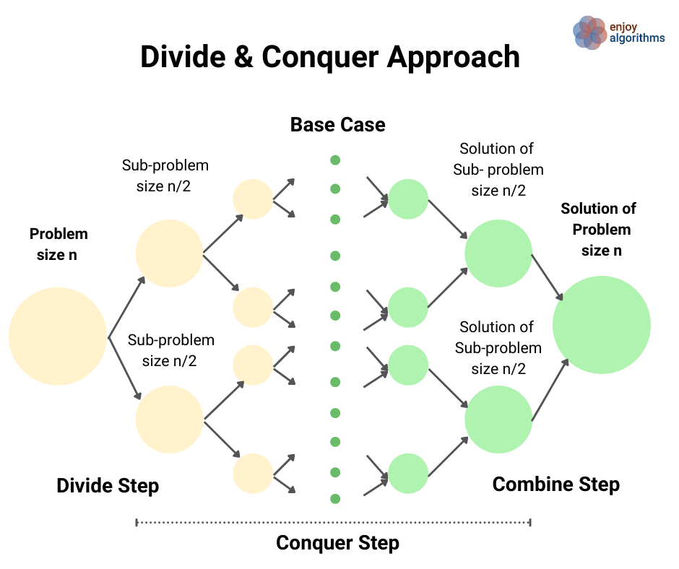
Divide and Conquer
Merge Sort
Quick Sort
Median of Two Sorted Arrays

Slide 84
Median of Sorted Arrays
There are two sorted arrays A[] and B[] of size n each, write a program to find the median of the array obtained after merging both the arrays i.e. Merged array of size 2n.
Example
A[] = [1, 3, 6] B[] = [2, 8, 12]
Output: 4.5

Slide 85
Solution
Here idea is to compare the medians of both sorted arrays and recursively reduce the search space by half.
Let m1 = A[n/2] and m2 = B[n/2], then
Case 1 if m1 == m2
Case 2 if m1 < m2
Case 3 if m1 > m2

Slide 86
Case 1: m1 == m2
ar1[] = {1, 12, 15, 26, 38}
ar2[] = {2, 13, 15, 30, 45}
combined list = {1, 2, 12, 13, 15, 15, 26, 30, 38, 45}

Slide 87
Case 2: m1 < m2
ar1[] = {1, 12, 15, 26, 38}
ar2[] = {2, 13, 17, 30, 45}
combined list = {1, 2, 12, 13, 15, 17, 26, 30, 38, 45}
We need to consider {15, 26, 38}, values greater than 15 and {2, 13, 17}, values less then 17.

Slide 88
Case 3: m1 > m2
Similar to previous case.

Slide 89
Backtracking
Backtracking is an improvement over the approach of exhaustive search.
It is a method for generating a solution by avoiding unnecessary possibilities of the solutions.

Slide 90
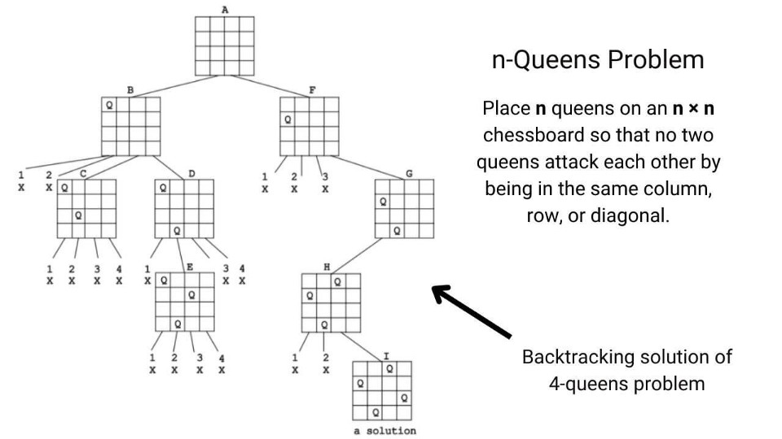
N-Queen Problem

Slide 91
Greedy
This solves as optimization problem by expanding a partially constructed solution until a complete solution is reached.
The greedy choice is the best alternative available at each step.

Slide 92
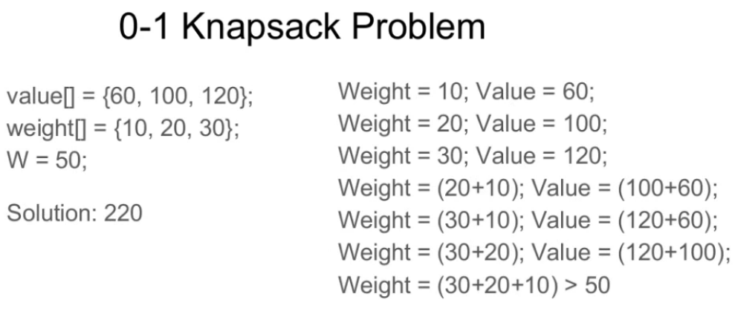
0-1 Knapsack Problem
Given weights and values of n items, put these items in a knapsack of capacity W to get the maximum total value in the knapsack.

Slide 93
Dynamic Programming
For solving problems with overlapping or repeated subproblems.
Here rather than solving overlapping subproblems repeatedly, we solve each smaller subproblems only once and store the result in memory.

Slide 94
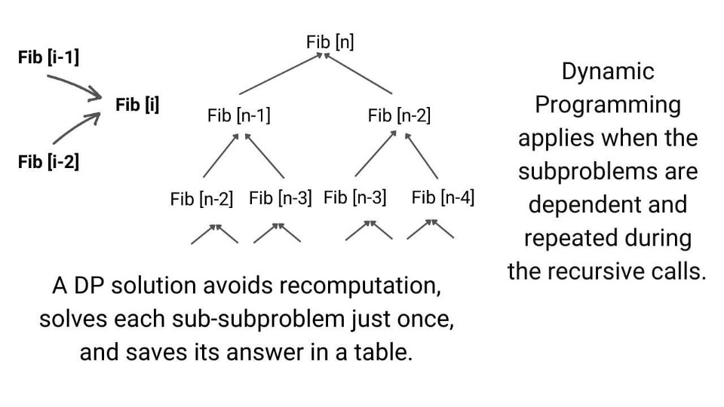
Fibonacci Sequence

